Slide 1

Welcome to join the class

Slide 2


Mohammad Zubayed Hossain
Assistant Teacher
Bhawman Talabaha Model High School
Kaliakair , Gazipur.
zubayed.gazi @ gmail . com

Slide 3

Schedule
Class : Eight
Subject : English 2nd paper
Time : 50 minutes
Date : 4 . 7 . 13

Slide 4
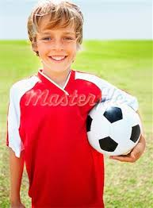
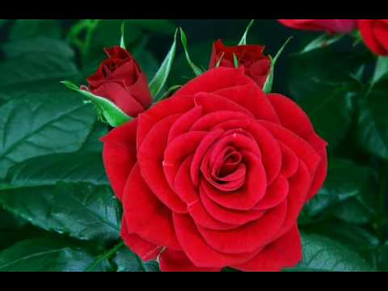
Look at the picture and think about that.

Slide 5
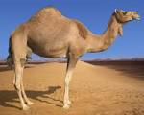
Degree of comparison

Slide 6
Learning outcome :
After this session students will be able to
Identify degree .
Fill up the blanks with appropriate adjectives .
Compare with positive, comparative and superlative degrees by making sentences .

Slide 7
Do you know what is called degree of comparison ?
Definition of Degree of Comparison : To compare between person to person or material with material according to their Faults , qualities , conditions adjective changes its form .The percentage of its variation and transformation is called degree of comparison .
Degree of Comparison are three kinds :
1 . Positive degree .
2. Comparative degree .
3. Superlative degree .

Slide 8



1. Positive degree : When adjective is not used to compare , only is used to show one noun’s or material’s fault and quality is called positive degree .
2 .Comparative degree : When adjective is used to compare between two nouns or two materials according to their faults qualities and conditions is called comparative degree .
3 . Superlative degree : When adjective is used among nouns to compare them then it is called superlative degree .
Notes:
ve

Slide 9
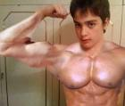
Structure of positive degree : ( A ) Subject + verb +adjective + object
Rana is a ……. Boy.
Rana is a strong boy .

Slide 10
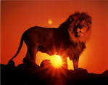

Structure of positive degree to present equal of two things :
Np 1 + verb + as + adjective +as +Np 2 .
Lion is as……………….as Tiger.
Lion is as ferocious as Tiger .

Slide 11
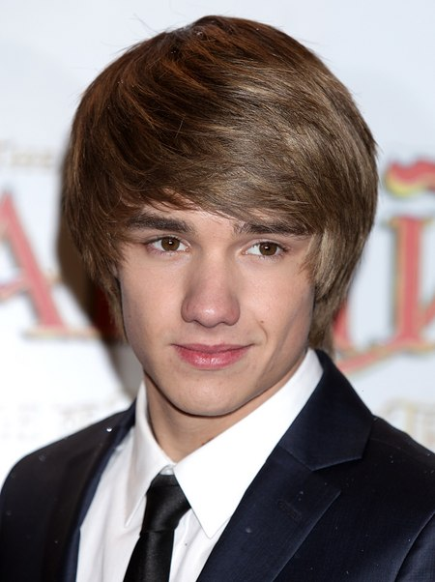
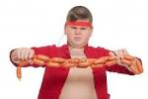
Structure of positive degree for negative sentence :
Np1+ verb negative form +so +adjective +as +Np2 .
Roky isn’t so good as Rony .
or Roky isn’t as good as Rony.

Slide 12
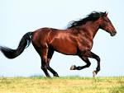
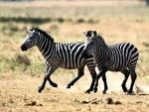
2 .Structure of comparative degree : Subject + verb +adjective +er + than + object .
NB . Latin words such as senior ,junior ,major ,minor , prefior etc if one
Of them is used in the comparative degree instead of “then” “ to” will be used .
Horse runs …………….. than Zebra .
Horse runs faster than Zebra .

Slide 13
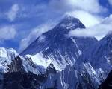
. Structure of superlative degree : Subject +verb +the + adjective + est+ of / in + obj
(in plu ) .
The Himalayas is the ……………. mountain .
The Himalayas is the tallest mountain .

Slide 14
Group work :
Fill up the blanks with appropriate adjectives .
(a ) The jamuna is the …….. river in our country ( b) No other city is as …….as Dhaka . (c ) Lili is not so …..Shila . (d ) Mecca is the ………..place of Muslims . (e) Nafiz is…..than any other boy .(f) Computer is the……….important thing . (g) He is….to me . (h) Nila is….than Mila .(i) Humayun Ahmed is the….writer. (j) Fox is….than any other animal .

Slide 15
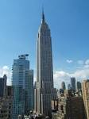
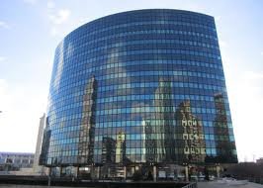
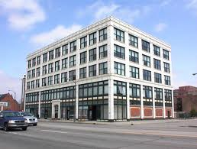
Rules of forming comparatives and superlatives :
Rule- 1 :For one syllable adjective er and est will be added as for comparative and superlative .
High building ……. building …….. building
High building higher building highest building

Slide 16
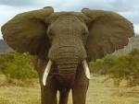
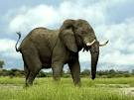
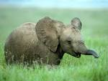
Rule- 2 : If the last letter of an adjective is consonant and before it there
has a single vowel then consonant will be double and then er ,est as for
Comparative and superlative.
Big Elephant …………….. Elephant ……………… Elephant
Big Elephant bigger Elephant biggest Elephant

Slide 17

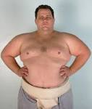

Rule-3 : If the last letter 0f an adjective is “ y” and before “y” there has a consonant In that case instead of “y” “I” will be introduced then er , est as for comparative and superlative .
Healthy man ……………….. man ……………….. man
Healthy man healthier man healthiest man
Notes:
aa

Slide 18
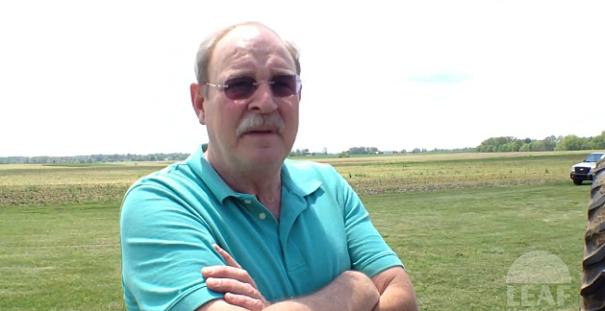

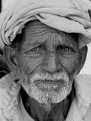
If before “y” there has a vowel then “y” will not be omitted .
Gay Gayer Gayest

Slide 19
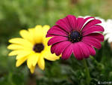


Rule- 4 : If the adjective word is constructed with two or more syllable in that case more and most will be added before adjective as for comparative and superlative .
Beautiful flower ……………… flower …………………. flower
Beautiful flower more beautiful flower most beautiful flower

Slide 20
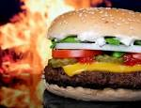
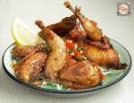

Rule – 5 : Some adjectives follow no rules :
Many food ……….. food ……….. food
Many food more food most food

Slide 21
Evaluation
What is the structure of comparative degree ?
Make comparative and superlative degree with the following adjectives :
  Cold
  Hot
  Intelligent
  Bad
  Happy
  Important
  Good
  Comfortable
  Old
  Grey

Slide 22
Home work:
Home work :
Use each of the following adjectives as a positive , comparative and superlative degree i n the sentence :
small , young , brave , much ,difficult .

Slide 23

Thanks to all

